Slide 1
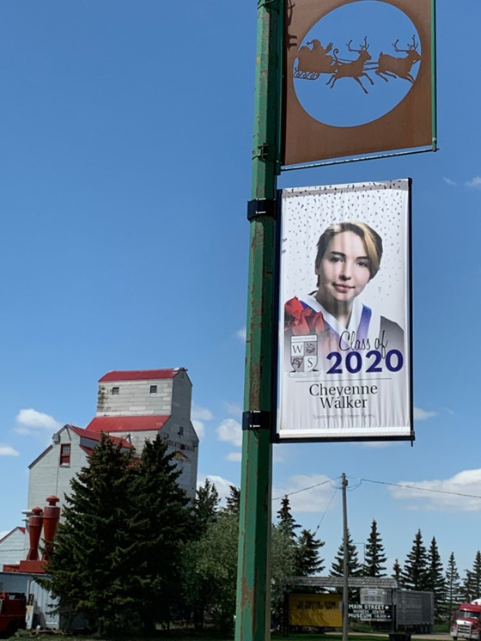
Metal Banner Examples

Slide 2
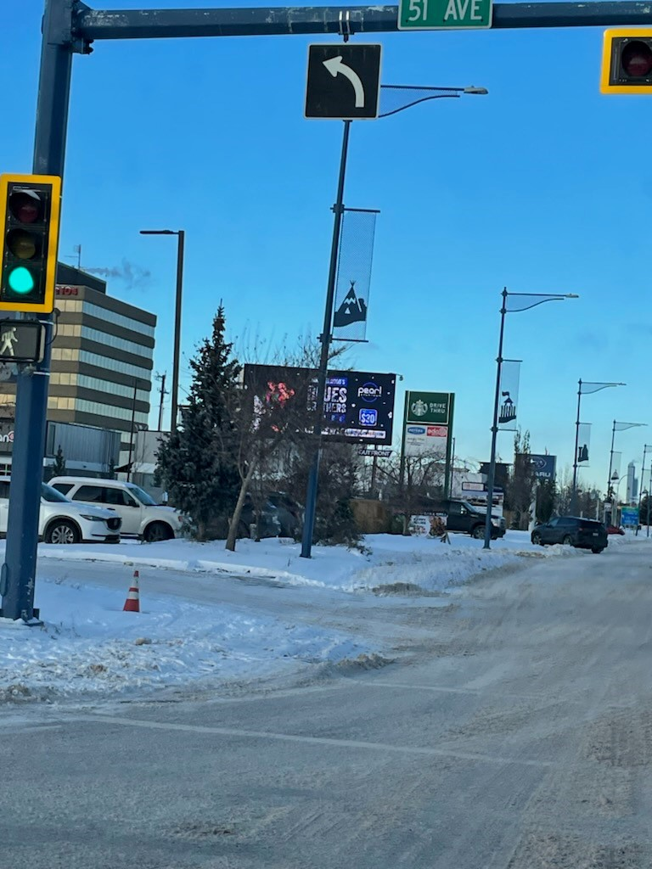
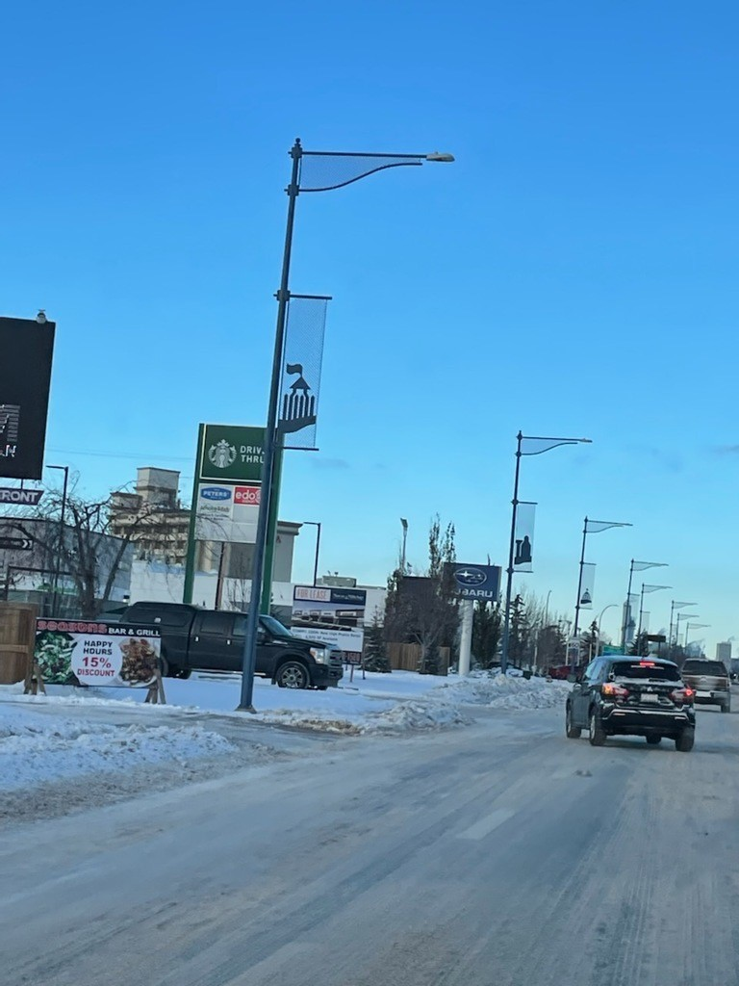
Metal Banner Examples

Slide 3
Light Pole Locations – 2nd Avenue West south city entrance

